Slide 1
CMT Final Exam
Madisyn Holcomb Period 2

Slide 2
Silhouette

Slide 3
Pen Tool Drawing

Slide 4
Sabino T-Shirt

Slide 5
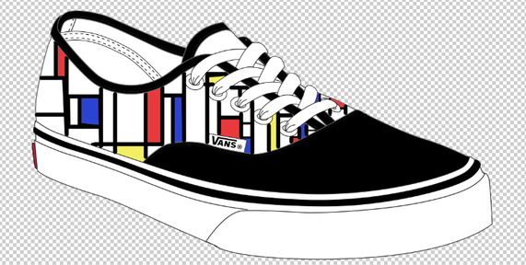
Vans Shoes

Slide 6
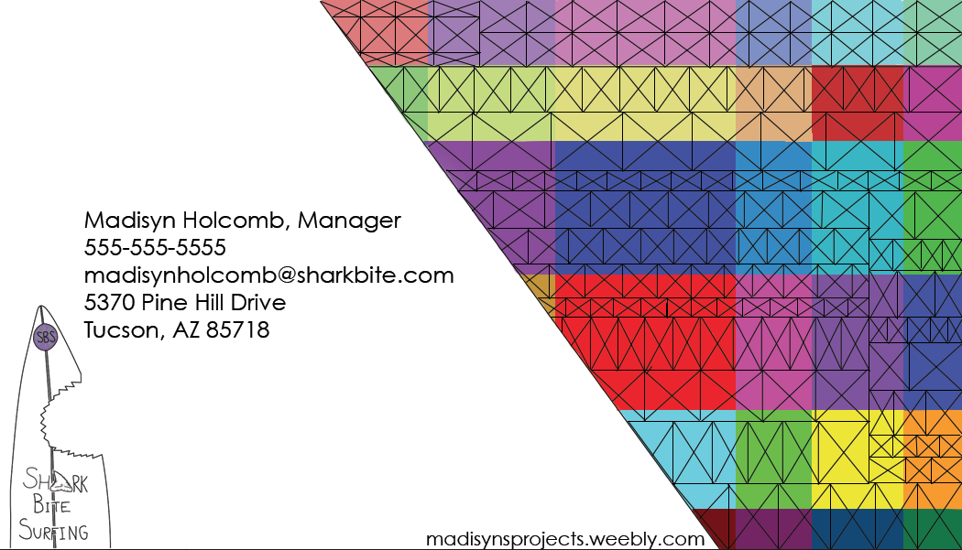
Business Card

Slide 7
Watercolor Effect

Slide 8
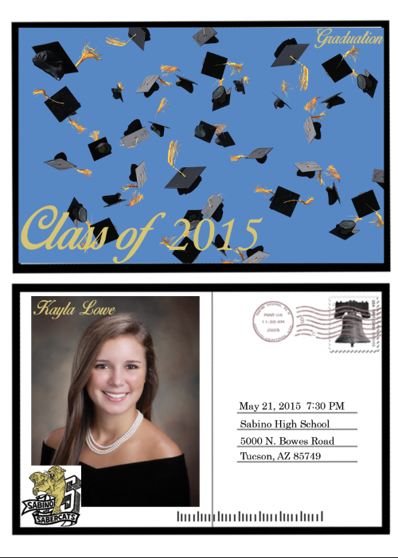
Senior Graduation Assignment

Slide 9
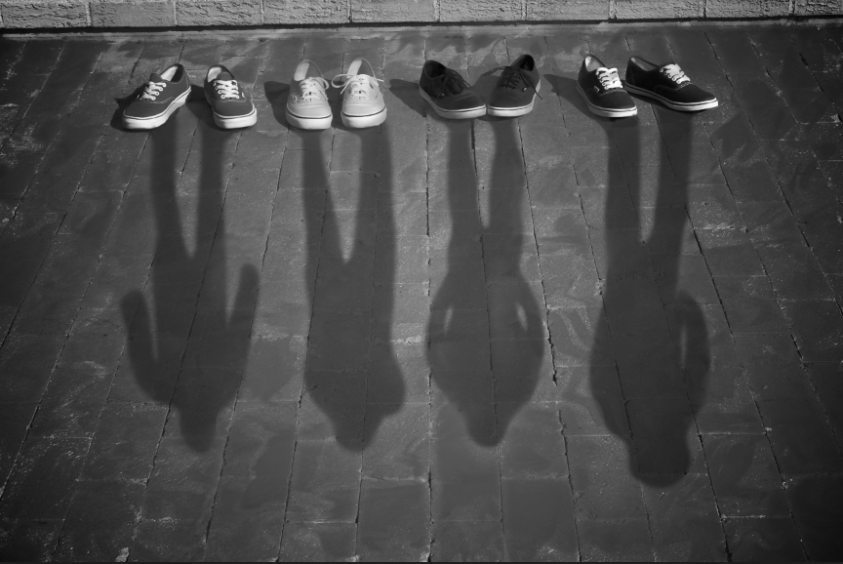
Jostens Conceptual Photo

Slide 10
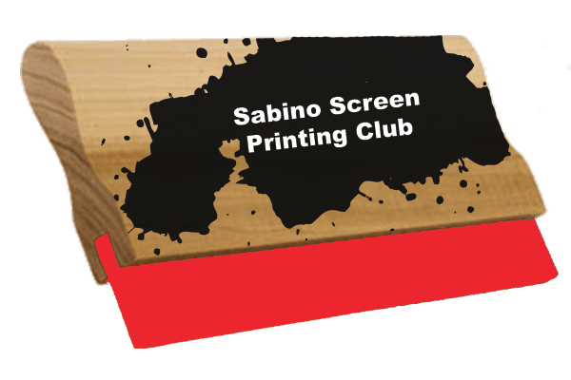
Screen Printing Club Logo

Slide 11
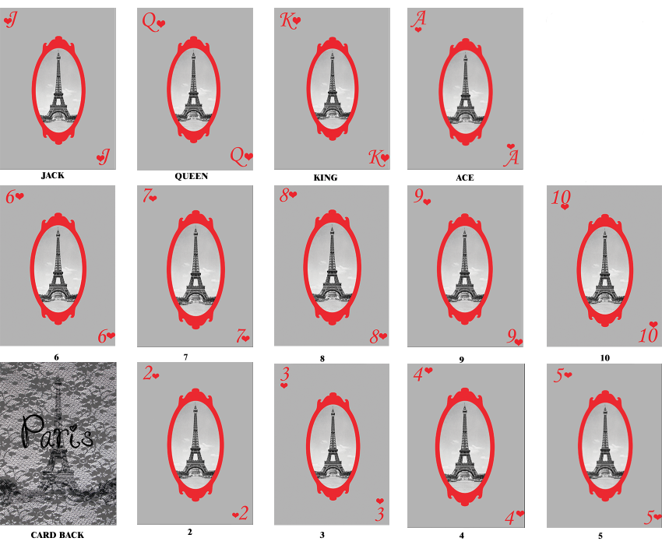
Set of Cards From One Suit

